Slide 1


Bank of Baroda Hackathon - 2022
Technology Partner
Your Team Name : ELEMENTRIX
Your team bio :
Date :18.09.2022

Slide 2
Problem Statement? Tampering with the Cameras/Sensitivity or High Priority Area.
Why did you decide to solve this Problem statement?
Criminals often resort to camera tampering to prevent the capture of their actions. Real-time automated detection of video camera tampering cases is important for timely warning of the operators. Tampering is generally done by obstructing the camera view by a foreign object, displacing the camera, and changing the focus of the camera lens. In automated camera tamper detection systems, low false alarm rates are important as the reliability of these systems is compromised by unnecessary alarms and consequently, the operators start ignoring the warnings. We propose adaptive algorithms to detect and identify such cases with low false alarm rates in typical surveillance scenarios where there is significant activity on the scene.

Slide 3
User Segment & Pain Points
Which user /advertiser segment would be early adopter of your product & why?
Our early adopters will be,
Banks and ATMs,
Luxury Hotels,
Major Companies,
Lockers. Our product will be used majorly in Highly secured places as above mentioned.

Slide 4
How Tamper Detection works?
Tamper detection allows your camera to alert you when its ability to record has been impacted. Especially helpful for locations where the camera may be physically attacked or blocked.
Tamper detection can also be set to send alerts based on the duration of the disruption, so a stray leaf caught on the camera for a few seconds won’t trigger anything but spray painting the camera will trigger an alert.
We will be using Computer Vision to solve our problem. Differences between the older frames and recent frames will be monitored and based on it, the decision of tampering or not will be taken.

Slide 5
TYPES OF TAMPERING:
DETECTION OF OBSCURED CAMERA VIEW
CAMERA DEFOCUSING
EDGE CORRESPONDENCE CHECK(ECC)

Slide 6
Detection of obscured camera view :
When a camera view is obscured by an object or sprayed with paint, it is expected that the histogram of In is skewed towards the lower end of the grey scale. The proposed algorithm first calculates the histograms of In and Bn.
Then the maximum values of the histograms are compared to check if In has a higher peak than Bn and if In has a higher peak then histogram of the absolute difference |In- Bn| is checked to see if it is skewed towards the black values.
For an obscured camera view, it is expected that this difference image has higher values near the black end. The above comparisons can be also carried out in low-low subimages of the wavelet transform. This, in fact, increases the robustness of the overall scheme because small changes

Slide 7
CAMERA DEFOCUSING:
The aim of this module is to detect reduced visibility in the conditions like fog, smoke or camera lens getting out-of-focus. The characteristic of reduced visibility condition is the absence of small scale detail over a large region of the image which implies diminished high frequency energy.
Wavelet transform provides a convenient means of calculating high frequency energy because edges in the original image produce high amplitude wavelet coefficients and extrema in the wavelet domain .
Comparison of the amount of detail could be done by comparing the energy of wavelet detail coefficients. A significant loss of details and edges in the current image In compared to the background Bn implies reduced visibility

Slide 8
Edge Correspondence Check (ECC) :
Edge correspondence check is used to confirm that a camera still is or is not monitoring the same scene. This emerges from the proposition that, if a camera is viewing the same scene, the location of the edges in Bn, which holds the long term scene information, and In, which is the current image should match.
If the camera view is obscured, visible scene would be different. On the contrary, in the case of detection of reduction of visibility, camera would still look towards the same scene. Edge correspondence could be checked by looking at the number of matching edge pixels.

Slide 9
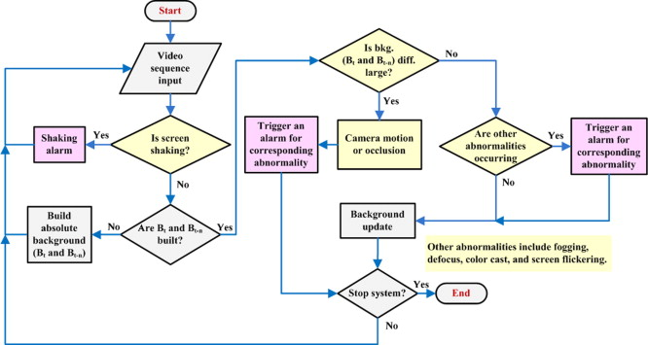
Any Supporting Functional Documents

Slide 10

SOURCE CODE:

Slide 11
Pre-Requisite
Anomaly and tampering detection of cameras by providing details
(Sayyed Mohammad Hosseini and Amir Hossein Taherinia) in 2016
DOI:10.1109/ICCKE.2016.7802134
UHCTD: A Comprehensive Dataset for Camera Tampering Detection
(Pranav Mantini and Shishir K. Shah) in 2019
DOI: 10.1109/AVSS.2019.8909856

Slide 12
Azure tools or resources
JUPYTER

Slide 13
References
Anomaly and tampering detection of cameras by providing details
(Sayyed Mohammad Hosseini and Amir Hossein Taherinia) in 2016
DOI:10.1109/ICCKE.2016.7802134
UHCTD: A Comprehensive Dataset for Camera Tampering Detection
(Pranav Mantini and Shishir K. Shah) in 2019
DOI: 10.1109/AVSS.2019.8909856

Slide 14
GitHub Repository Link & supporting diagrams, screenshots, if any
How far it can go?

Slide 15
Thank You
Team member names
VARSHINI S
SARAVANAKUMAR J
SUNDARRAJAN
T J GOPIKRISHNA

